Slide 1
Predicting Rates of Chronic Absenteeism in NYC Schools
Capstone 3 Final Presentation

Slide 2
Problem Identification Overview
What is the next year’s chronic absenteeism for a school and it’s demographic groups?
Absenteeism huge indicator of student success and impacts school funding.
Once chronic absenteeism is high, difficult and costly to remediate.
proactively intervention would save time, money, and resources, and increase student/school outcomes.
NYS Chronic Absenteeism, absent 18 or more days
Notes:
Absenteeism is a huge indicator of student success and also impacts school funding. If students are not in school they cannot learn or graduate. Once students and schools have high chronic absenteeism rates, it is a very difficult and costly problem to remediate.
Being able to predict a school’s attendance/chronic absenteeism numbers and identify the contributing variables would allow district administrators to proactively intervene with these school’s ahead of time. Saving time, money, and resources, as well as increasing student/school outcomes. We used NYC OpenData’s school-level attendance data from 2013-2019
- Define the question specific to modeling activities
e.g Predict vacancy rate by zip code
- Identify the data needed and or available:
e.g US national current vacancy data, by zip code data from 2011-2018. Need vacancy rate by zip code 2019-2020
- Define the data Timeframe:
e.g. see above bullet
- Describe the Modeling Response:
e.g. percentages 0-100%
-Unsupervised or Supervised Classification or Regression Model:
E.g. Regression Model
-What Deliverables will be generated:
E.g. github folder outlining modeling process from data exploration to best model results.

Slide 3
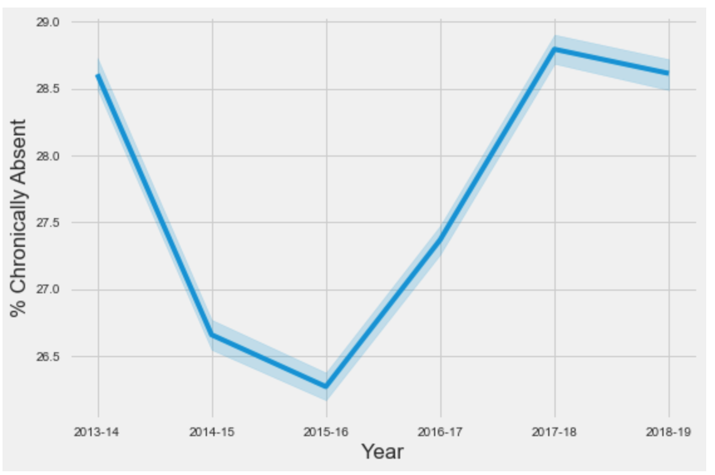
% Chronically Absent Over Time

Slide 4
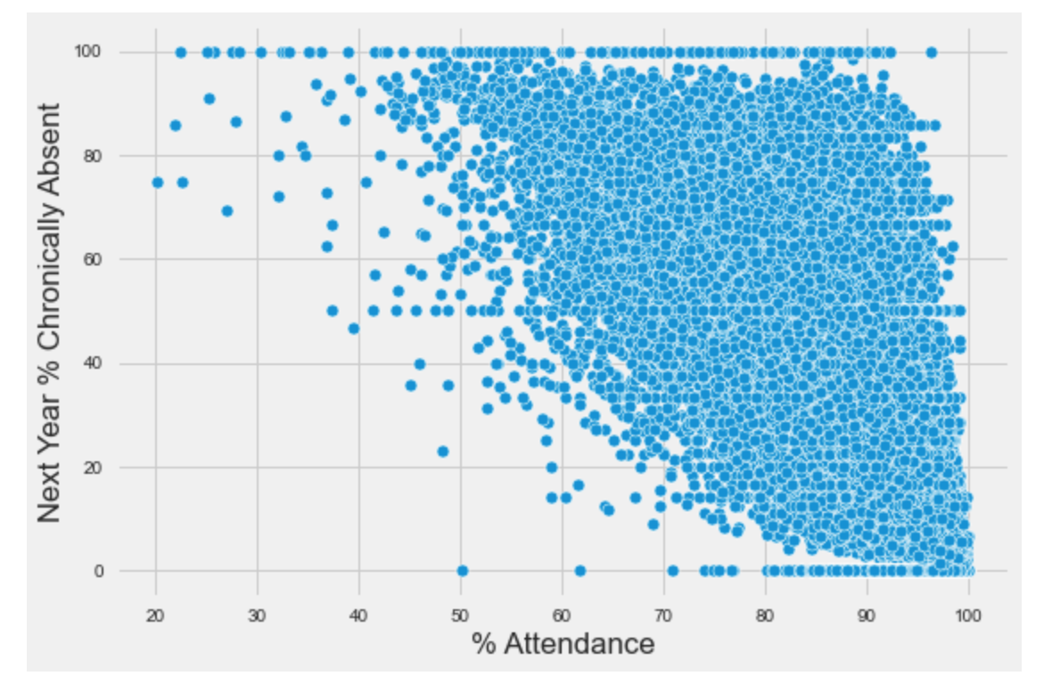
% Attendance vs Nex Year’s % Chronic Absent

Slide 5
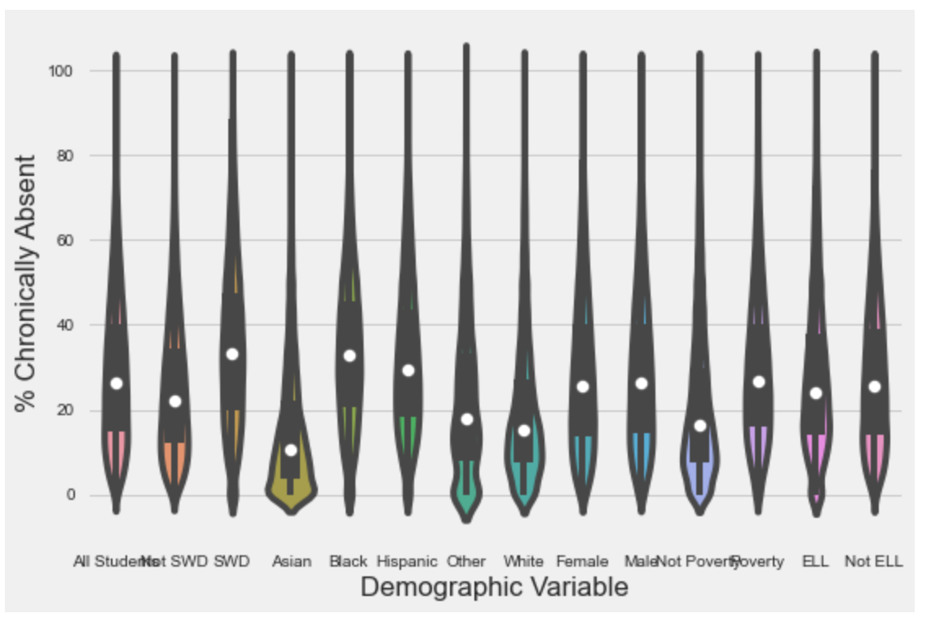
% Chronically Absent by Demographic Variable
Notes:
With Students with disabilities (SWD), Black and Hispanic students having the highest % Chronically Absent. While, Asian, and White students have the lowest % Chronically Absent.
Not SWD has much lower % Chronically Absent than SWD, Not Poverty has much lower % Chronically Absent than Poverty.
Male/Female have similar rates of % Chronically Absent (Females have slightly less). And ELL has very slightly lower % Chronically Absent than Not ELL
These may be an interesting relationships to look further into, with the goal of closing the gaps more in the other groups

Slide 6
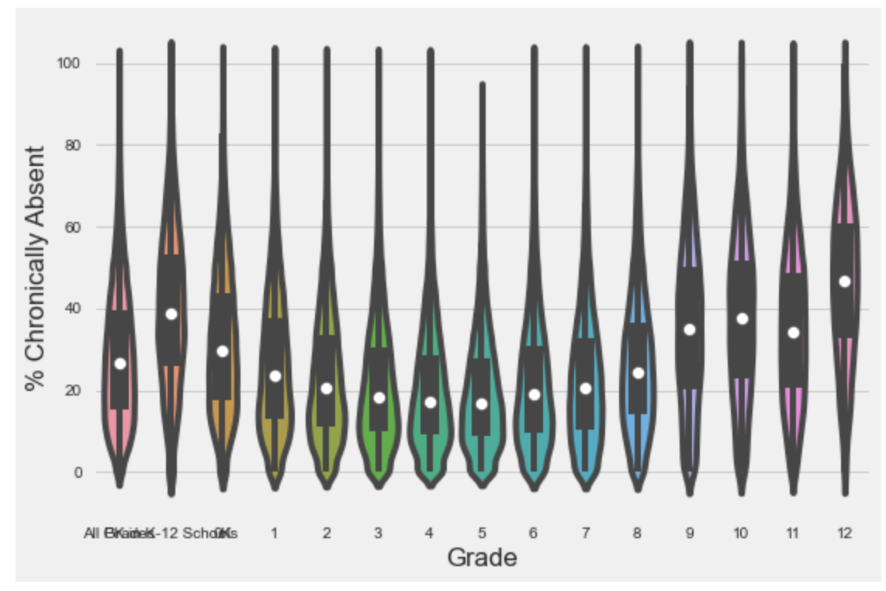
% Chronically Absent by Grade
Notes:
Grade and % Chronically Absent also have a lot of variation
There is a parabolic relationship with the highest rates of % Chronically Absent in PreK/K and 9-12 grade (high school). 12th grade having the highest of around 45-50% chronically absent.
The lowest % Chronically Absent can be seen from 2-7th grade (around 20% or less)

Slide 7
Data Preprocessing Steps of Note
Explored mystery ‘s’ in numeric data
created the variable 'Next Year % Chronically Absent'
Dealt with highly correlated variables (goal = model generalizability)
Created target variable ‘Next Year % Chronically Absent’ for multiclass classification & regression
‘High’ = 1 std deviations above mean
‘Med’ = +/- 1 std from mean
‘Low’ = 1 std dev below mean
Notes:
An email was sent to NYC OpenData on 12/14/20 to inquire about the non-numeric data (remember 's' was in each of these variables before I replaced it with NaNs). The response from NYC Open Data was such, "When data counts are low so as to potentially result in the identification of students, those numbers are redacted. the 's' indicates a low number that we have redacted." Due to this I decided to drop this NaN data from the data set.
dropped highly correlated variables that had been identified in EDA and retained the variables that made the model more generalizable (the retained features more schools would have data on)

Slide 8
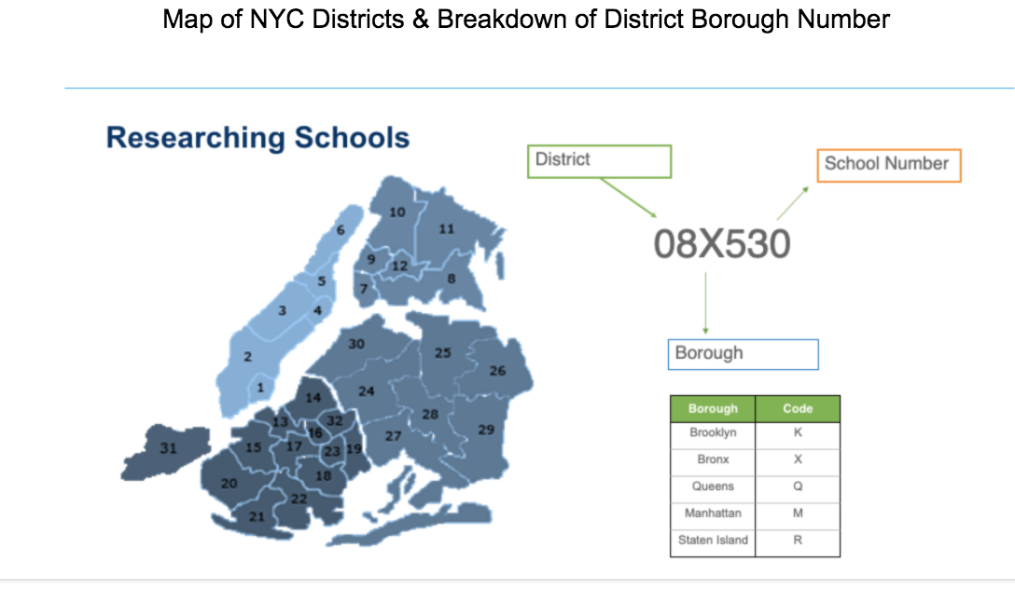
Data Preprocessing Steps of Note
Categorical Values
Reducing Number,
Retaining Information
Notes:
There were several categorical variables - over 1600 unique schools, 15 grades, 6 years and 14 demographic variables). To reduce the number of variables in DBN (District Borough Number) and School Name, I split DBN into its 3 components, see explanation of DBN here. They are: District Number, Borough Code, and School Number. Then I retained district number and borough code while dropping school number, and borough code. This will make our dummy variables more manageable and our model more generalizable to a school's location.
As noted I dropped DBN, school name, and school number in anticipation of dummy variable creation. I dropped Borough Code/Name because it is highly correlated with District Number, and District Number has more info and district Number also has more correlation with target variable. I also dropped the columns (# days absent, # days present) because I realized the '’% attendance' column has this info and we don't have these variables in current daily data from NYC OpenData. I separated 2018-2019 data from 2013-18 school years for later predicting, did a final check NaNs in resulting dataframe (2013-2018), for now, will drop these NaNs until further research is conducted (see note of this in second paragraph of this section).

Slide 9
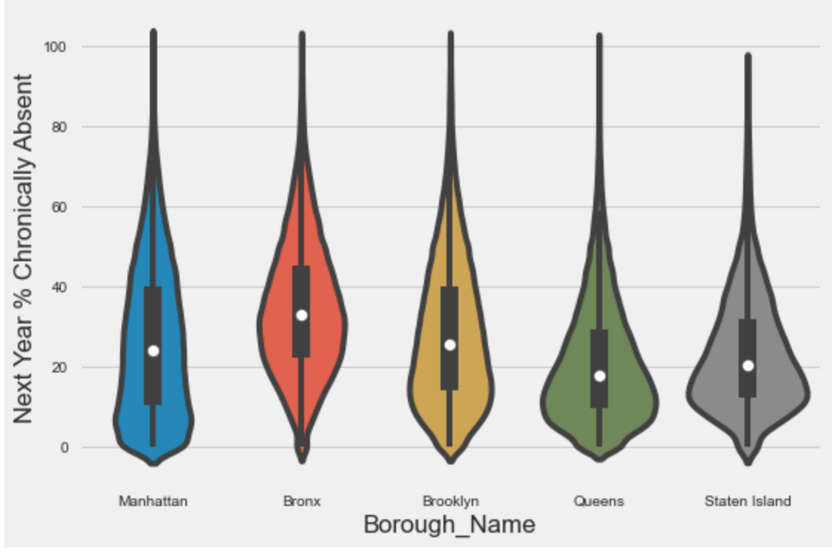
Next Year % Chronically Absent by Borough
Notes:
Zooming out you could see the variation across boroughs, Queens and Staten Island have the lowest rates of chronically absent students, followed by Manhattan and then Brooklyn (have larger ranges than the others), while Bronx has the highest, and seems to be more normally distributed than the others:

Slide 10
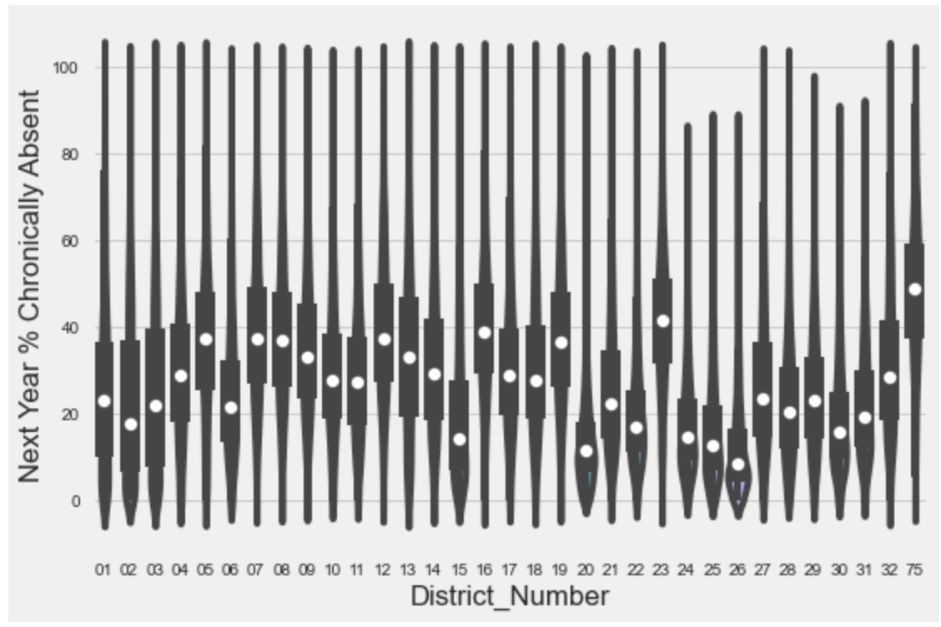
Next Year % Chronically Absent by District
Notes:
Lots of variation here

Slide 11
Data Preprocessing Steps of Note
Created separate target variables and dataframes for regression vs classification
Created baseline scores from current year’s chronic absenteeism
63% accuracy with Linear Regression with only % Chronically Absent’
77% accuracy with Decision Tree with only ‘% Chronically Absent’
Notes:
I created separate dataframes for regression (where the target variable is 0-100%) vs. classification (where the target variable is ‘High’, ‘Medium’, or ‘Low’) and created dummy variables for the two data frames.
I then split into testing and training datasets usingelected not to standardize the magnitude of numeric features using a scaler because the numeric variables only go 0-100 and the dummy variables are simply 1s and 0s.

Slide 12



Data Preprocessing Steps of Note
New Feature Creation
Notes:
As noted above in additional preprocessing, after using Last Year's % Chronically Absent to Predict Next Year's as a baseline comparison, I found that this one variable led to an R2 of .64 for linear regression and an accuracy of .77 with a Decision Tree. Meaning the previous models were not outperforming this baseline. So we tried adding 5 additional features (see preprocessing above for more information).
the difference between each value's '% Chronically Absent' and the 5 year averages of '% Chronically Absent' (grouped by DBN, Grade, & Demographic Variable)
the difference between each value's '% Attendance' and the 5 year averages of '% Chronically Absent' (grouped by DBN, Grade, & Demographic Variable)
the difference between each value's '% Chronically Absent' and the 2 year averages of '% Chronically Absent' (grouped by DBN, Grade, & Demographic Variable)
the difference between each value's '% Attendance' and the 2 year averages of '% Chronically Absent' (grouped by DBN, Grade, & Demographic Variable)
% Chronic Absent (which is essentially the previous year's % Chronic Absent as we are predicing the following year.
Also the column 'Year' was dropped, since the model was not predicting future year's due to our choice of 'Year' as a categorical value due to this, instead of a TimeSeriesSplit for we used a general Train/Test split. This led to increased model performance, especially for the regression models.

Slide 13
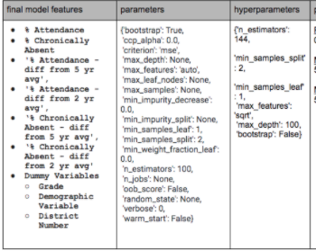

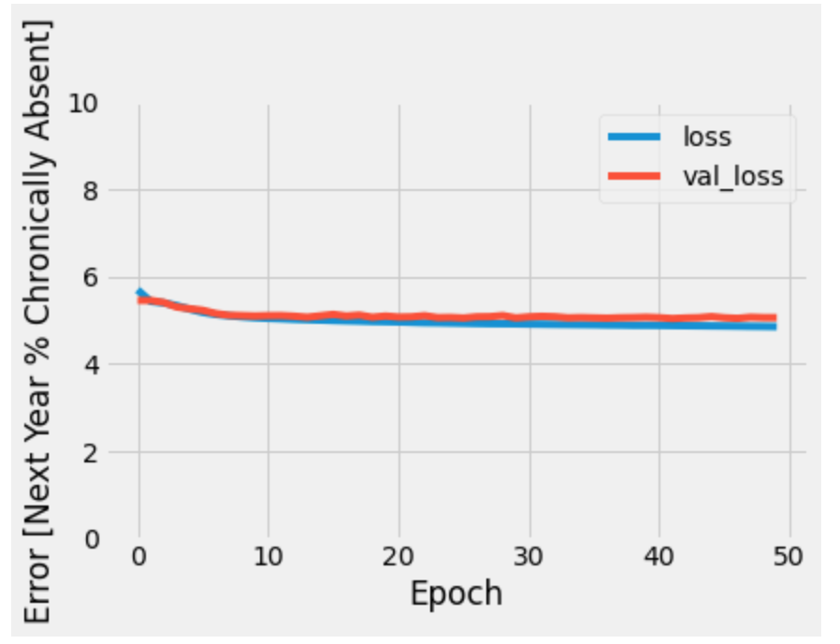
Model Description
Model Metrics - RandomForestRegressor()
Target Variable = 'Chronically_Absent_Next_Year'
Notes:
Tried many models both regression and classification
Regression: Linear, RF, Tensorflow DNN
Classification: Decision Tree, RF, KNN, Naive Bayes
Input data size and features
Model Algorithm and Parameters
Model iterations can be discussed here if they are not saved out separately

Slide 14
Model Performance
Model | R2 | MSE | MAE
Baseline - Linear Regression (X = ‘% Chronically Absent’, using last year’s % Chronically Absent to predict next year’s) | 0.662 | 105.51 | 7.51
Random Forest *Final Model | 0.824 | 54.97 | 5.14
Notes:
R², RMSE, Confusion Matrix, Precision & Recall, AUC/ROC
Best performing model is in terms of overall accuracy was the 'entropy' Decision Tree Classifier with max_depth of 7 (84.75% Accuracy), but that is not our best model choice. In many cases school districts would be most focused on the 'High' rates of Chronic Absenteeism (Meaning 1 standard deviation above the mean). For the 'High' class the Random forest classifer would be our first choice model as explained below.
It wil depend on what a district needs to manage more, False Positives or False Negatives, in deciding which model is best in reality.
too many False positives = may be ok for school districts with less constraintes (ie. larger budgets, more time for this kind of initiative), as they may want to ensure they got all the schools & groups that are at risk of high chronic absenteeism.
too many False negatives = may be ok for school disctricts with more constraints (ie. smaller budgets, less time for this kind of initiative), as they may want to ensure a school/group they focus on will really need it.
So in fact the Random Forest Model (80.4%) would be a great choice if you want to ensure you limited False Positives (and were ok with under-identifying schools/groups that are at risk of high chronic absenteeism), because the precision is higher while the recall is lower:
'High' Next_Year_Chronic Absenteesim:
precision: 0.75
recall: 0.63
f1-score: 0.68
support: 12980
However if you wanted to ensure you limited False Negatives (and were ok with over-identifying schools/groups that are at risk of high chronic absenteeism), then the Naive Bayes Classifer (52% Accuracy) would be the way to go, because although the precision is low the recall is much higher than other models:
'High' Next_Year_Chronic Absenteesim:
precision: 0.40
recall: 0.79
f1-score: 0.53
support: 12980

Slide 15
Model Findings

Slide 16
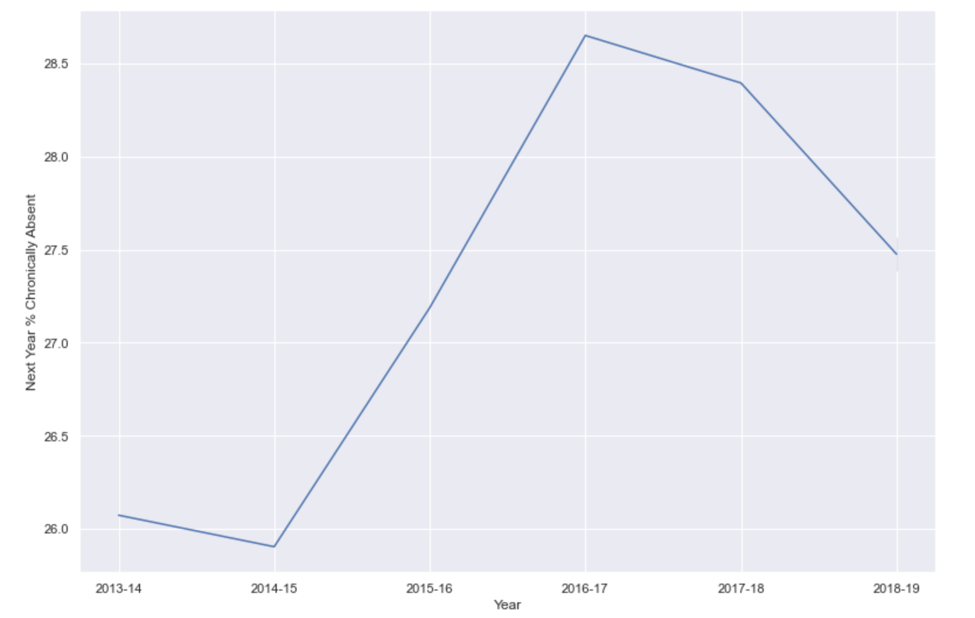
Next Year % Chronically Absent over Time
Notes:
Not predicting covid-19, as this was a black swan even

Slide 17
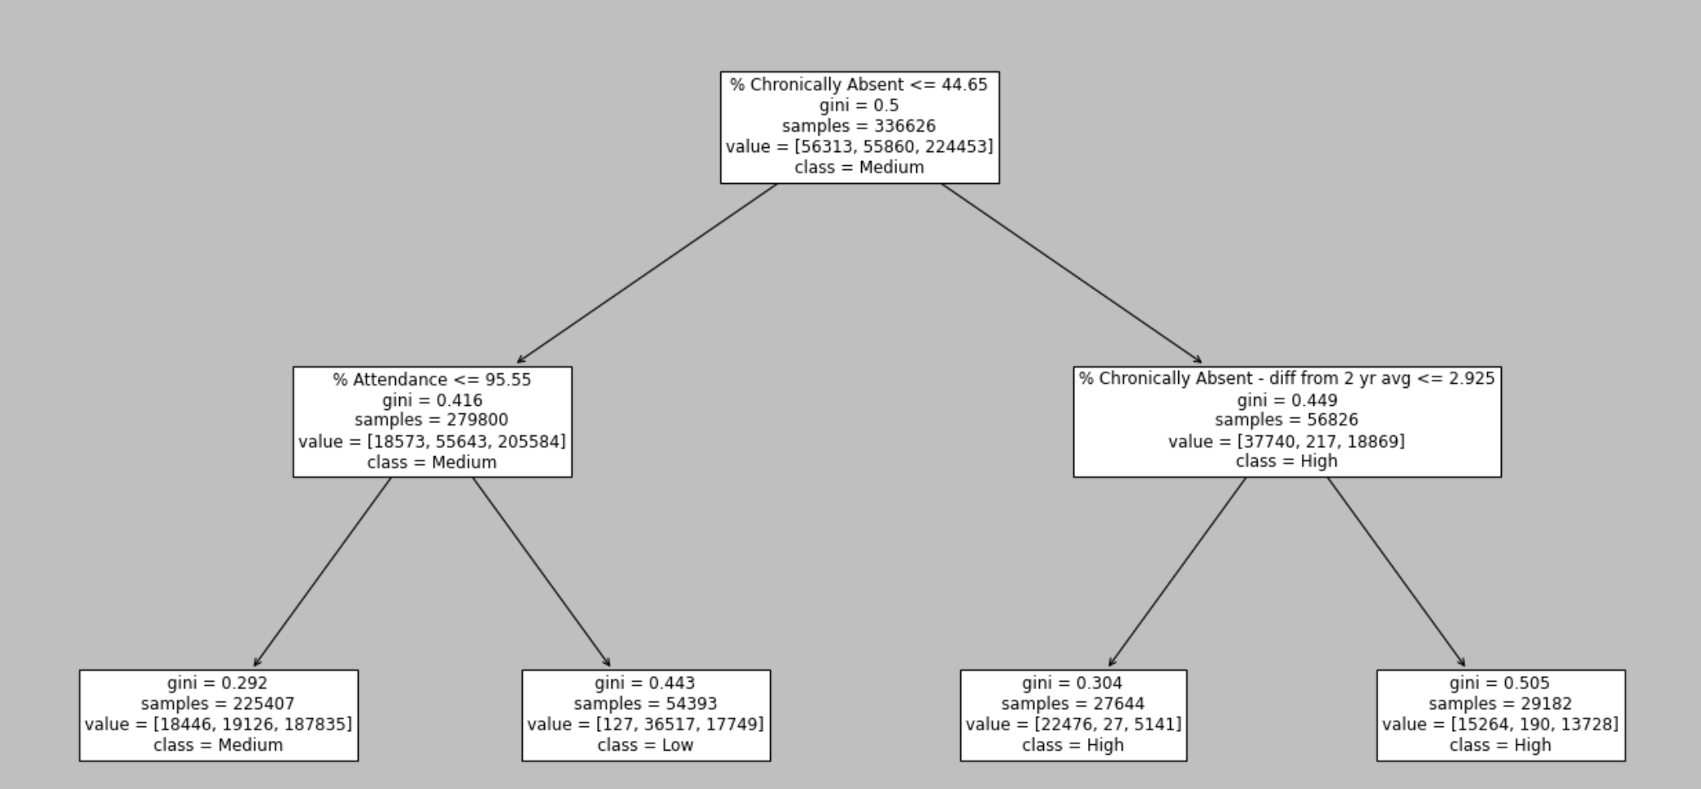
Decision Tree Classifier
Notes:
The plot shows that the model is simply using ‘%Attendance’, ‘% Chronically Absent’ & ‘% Chronically Absent - diff from 2 ye avg’ to predict the 3 classes. Although simple has some informative value to schools, it simply shows that if a school or student group within a school is Chronically Absent more than 44.65% of the time this year they will be in ‘High’ group of Chronically Absent next year. Also if they are at or below 44.65% Chronically Absent and above 95.55% attendance they will be in the ‘Low’ group next year and if there attendance is less than 95.55% than they would be in the medium group.
So for a school you could use the above numbers to set goals in order to decrease Chronic Absenteeism next year, ie. all schools/student groups have % Chronically Absent above 44.65 - this would essentially move these students out of the ‘High’ group. Then the secondary goal would be all schools/student groups have above 95.55% attendance. This would move students from ‘Medium’ to ‘Low’ group.

Slide 18
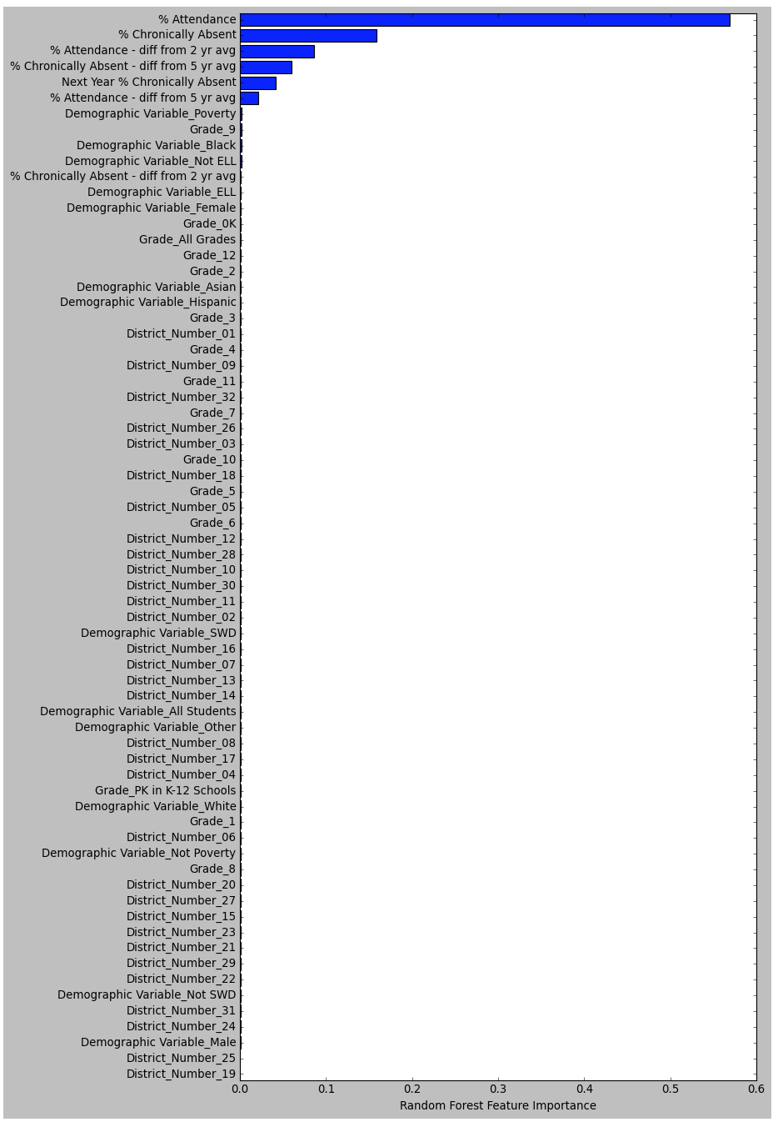
Feature Importance
% Attendance ~ 57%
% Chronically Absent ~ 18%
Difference from averages
~ 3-6%
Notes:
Feature Importances
Top 10 Feature ranking:
1. feature 1 (0.259725) - '% Chronically Absent'
2. feature 0 (0.225061) - '% Attendance'
3. feature 5 (0.084209) - '% Chronically Absent - diff from 2 yr avg'
4. feature 4 (0.081441) - '% Chronically Absent - diff from 5 yr avg'
5. feature 2 (0.065141) - '% Attendance - diff from 5 yr avg'
6. feature 3 (0.060453) - '% Attendance - diff from 2 yr avg'
7. feature 24 (0.015531) - 'Year_2016-17'
8. feature 72 (0.010620) - 'District_Number_75'
9. feature 21 (0.009390) - 'Year_2013-14'
10. feature 22 (0.008656) - 'Year_2014-15'

Slide 19
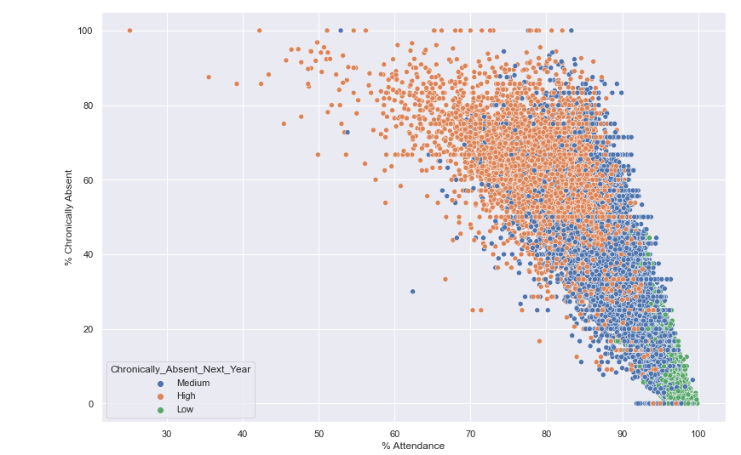
2 Most Important Features for Model
Notes:
Overlap and variance of ‘Medium’ group
Could be good target for intervention

Slide 20
At Risk Groups
Highest Rates of Chronic Absenteeism
grades 9-12
PreK & K
SWD
Black, Hispanic

Slide 21
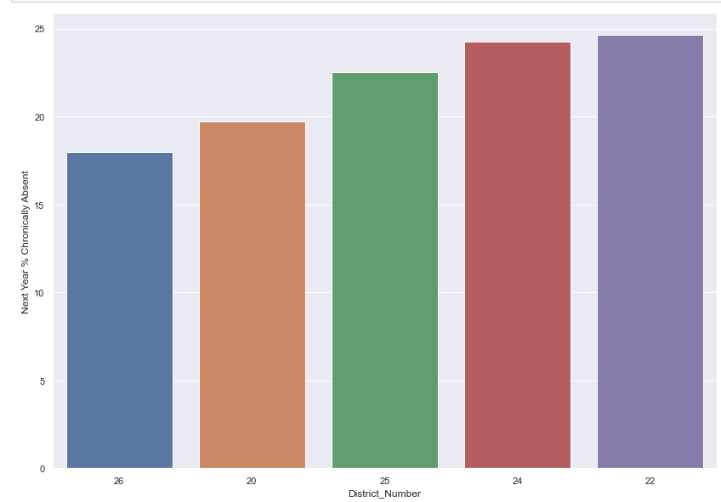
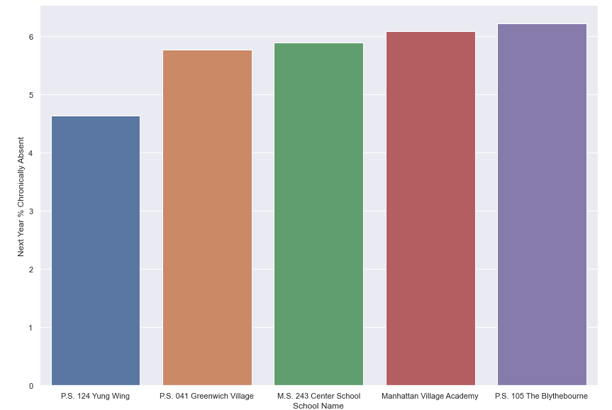
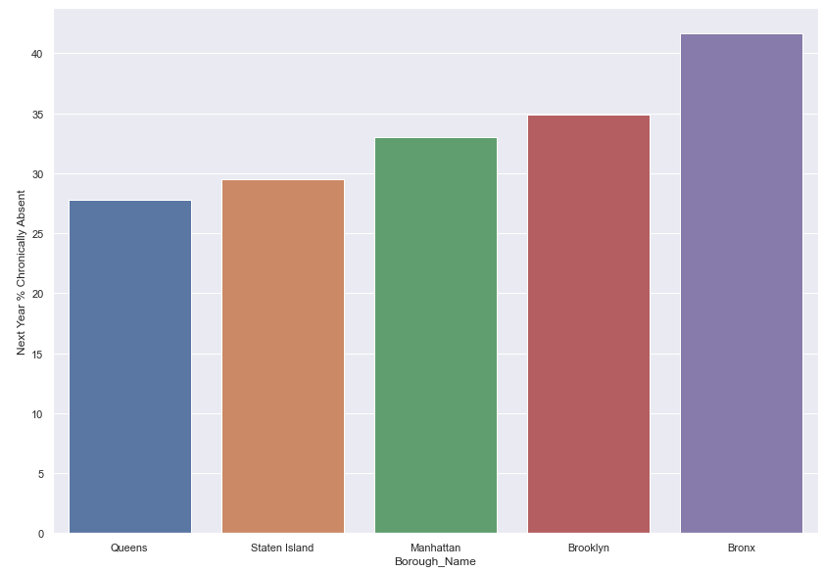
Lowest Chronic Absenteeism → SWD
Notes:
#(higher number = more instances)
Districts 1-6 Manhattan
D7-12 Bronx
D13-23, & 32 Brooklyn
D24-30 Queens
D31 Staten Island
Also can look at worst performing schools/districts/boroughs (highest rates of chronic absenteeism)

Slide 22
Client Recommendations
Create measurable goals
Target ‘Medium’ group
Target at risk populations → work with top performing schools
Targeted support
Districts, boroughs, schools
Grades, demographics
Notes:
USE THIS TO GET AHEAD OF THE PROBLEM

Slide 23
Future Research
Get more variables to increase model predictive power
School survey (parent input!)
Academic grades
Test more hyperparameters/models
turn chronic absenteeism from a multi class categorical variable to a binary variable. As we are concerned mostly with whether Chronic Absenteeism is 'High' or not.
Share with NYC DOE
Research why the exemplar schools (for high-risk categories) are doing so well.
Test predictions as real data comes out
Notes:
Ready for production?
Test new hyperparameters or different modeling methods

Slide 24


Slide 25
References - see hyperlinks
District Borough Number Image
'2' image
'5' image
'AVERAGE' image

